Slide 1
Named Entity Recognition for Digitised Historical Texts
by
Claire Grover, Sharon Givon, Richard Tobin and Julian Ball
(UK)
presented by
Thomas Packer

Slide 2
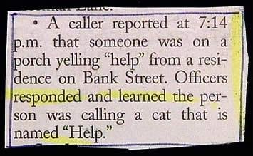
A Need for
Named Entity Recognition

Slide 3
Goal and High-Level Process
Automatically index historical texts so they are searchable.
Scanning
OCR
Text processing
Named Entity Recognition (NER)
Indexing
Search and Retrieval
Highlighting

Slide 4
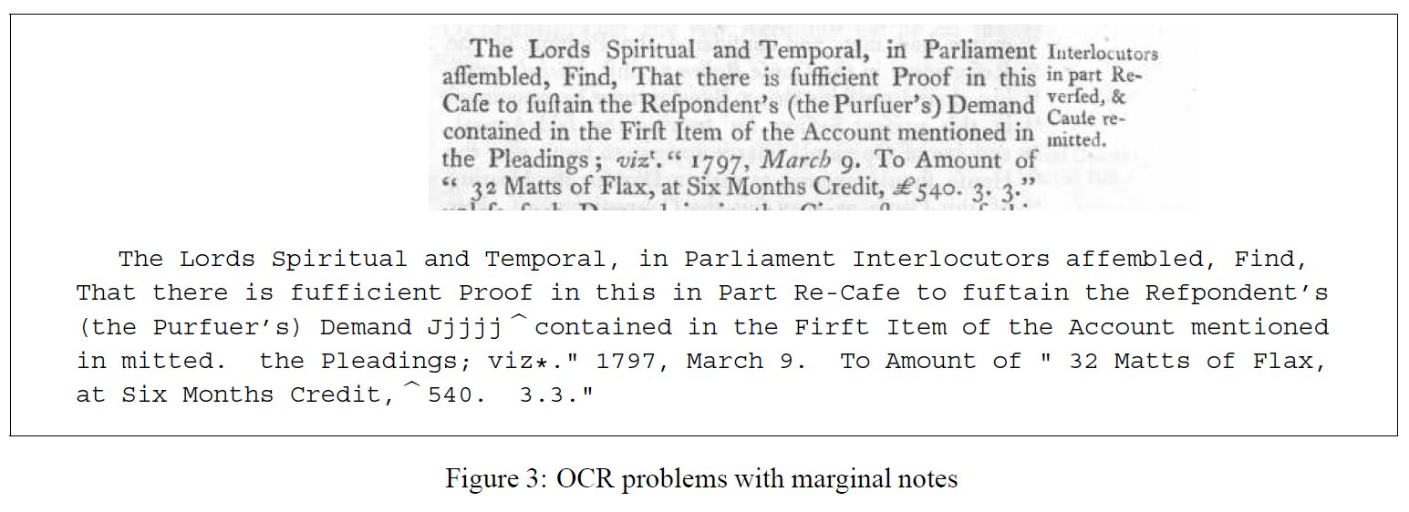
Challenges:
Document Structure

Slide 5
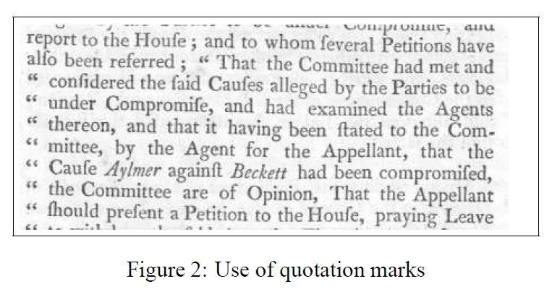
Challenges:
Placement of Tokens and Capitalization

Slide 6
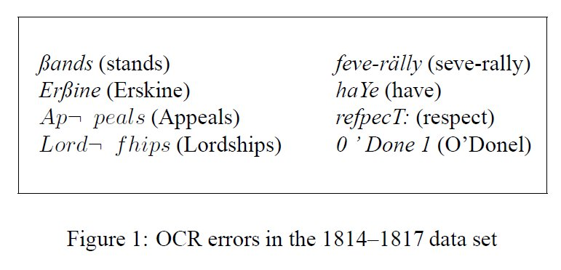
Challenges:
OCR Errors Abound

Slide 7
Challenges Related to ML:
Capitalization
CoNLL 2003 NER.
Trained and tested on English and German
Highest f-score for English: 88.8
Highest f-score for German: 72.4
Capitalization likely to be the main reason (usually a key feature in ML-based NER).

Slide 8
Challenges Related to ML:
POS
(Untested guess that) POS tagging would do poorly on OCR text.
Poor POS tagging would produce poor ML-based NER.

Slide 9
Challenges Related to ML:
Hand Labeling
Quality of OCR text and kinds of OCR errors vary greatly from document to document.
Traditional ML requires hand labeling for each document type.

Slide 10
Data
Annotated Data:
  British parliamentary proceedings
  Files: 91 (1800’s); 46 (1600’s).
  Person names: 2,751 (1800’s); 3,199 (1600’s).
  Location names: 2,021 (1800’s); 164 (1600’s).
Document Split:
  Training: none
  Dev-test: 45 docs (1800’s)
  Test: 46 files (1800’s); 46 files (1600’s)

Slide 11
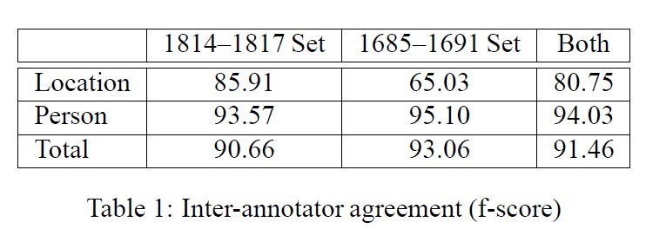
IAA, Balanced F-Score
Notes:
15 points for the approach -- explain the basic problem and how the authors attacked and solved the problem;

Slide 12
Process
UTF-8 Conversion
Re-tokenize
Token IDs
Mark-up Noise
OCR Engine
XML
Clean-up
XML
Extraction
XML
Specialist Person
Specialist Place
Generalist Person
Generalist Place

Slide 13
Clean-up
Convert to UTF-8
Separate trailing whitespace and punctuation from tokens
Adding IDs to tokens
Mark up noise:
  Marginal notes
  Quotes
  Unusual characters

Slide 14
Extraction:
Four Grammars
Specialist names, (monarchs, earls, lords, dukes, churchmen), e.g. Earl of Warwick.
Common names, e.g. Mr. Stratford.
High-confidence place names, e.g. Town of London.
Lower-confidence place names.

Slide 15
Extraction:
Several Lexicons
Male christian names
Female christian names
Surnames
Earldom place names

Slide 16
Extraction:
Rule Application
Apply higher-precision rules first:
  Specialist rules before generalist rules.
  Person rules before place rules.

Slide 17
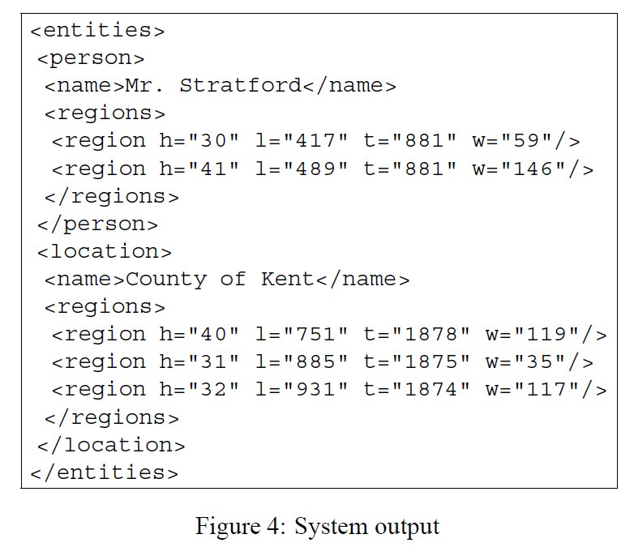
Output

Slide 18
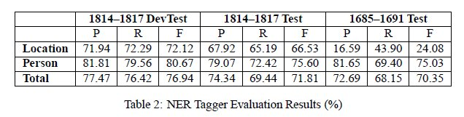
Results

Slide 19
Conclusions: Good & Bad
Good:
  Blind test set (developers did not look at).
  Computed IAA.
  Lots of entities labeled.
Bad:
  Reported IAA scores apparently not corrected after error was discovered. (Annotations corrected, but IAA score was not.)
  Why is extraction tied to XML processing?

Slide 20
Future Work
Improve rules and lexicons.
Correct more OCR errors with ML.
Extract organizations and dates.
Extract relations and events.

Slide 21
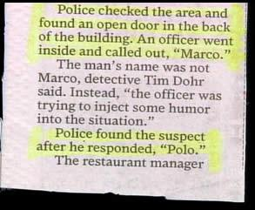
Successful
Named Entity Recognition

Slide 22
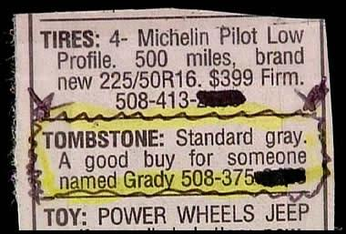
The Inconvenience of Good
Named Entity Recognition

Slide 23
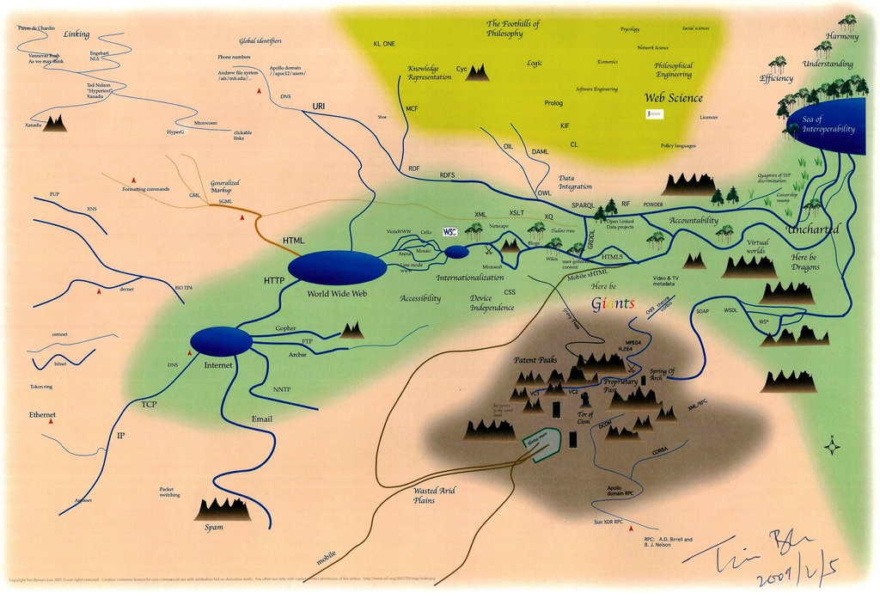
Questions
Notes:
5 points for answers to questions -- answer the questions as posed by the class.

